Slide 1
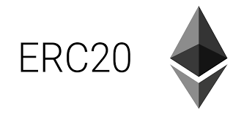

ERC20 Custom Token Tutorial

Slide 2
Who Am I? Researcher at Computing/Business School. Senior Data Scientist Specialty : NLP/NLU mailto: amit.prs@nus.edu.sg
LinkedIn
Twiiter

Slide 3
What are tokens?
Say you want to issue share of stocks to the many cofounders (different percentages) for your new startup company that is yet to be registered.
In the Ethereum world, you can represent the shares in the form of “tokens” that can be sold, sold back to the company, transferred, etc.
You can create a “token contract” and deploy it in Ethereum blockchain.
Then the tokens can be transferred, sold, etc.

Slide 4
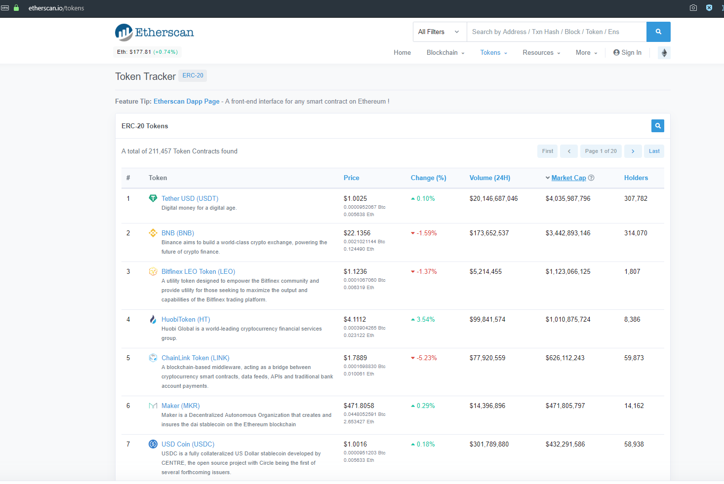
Popular Ethereum Tokens

Slide 5


Slide 6
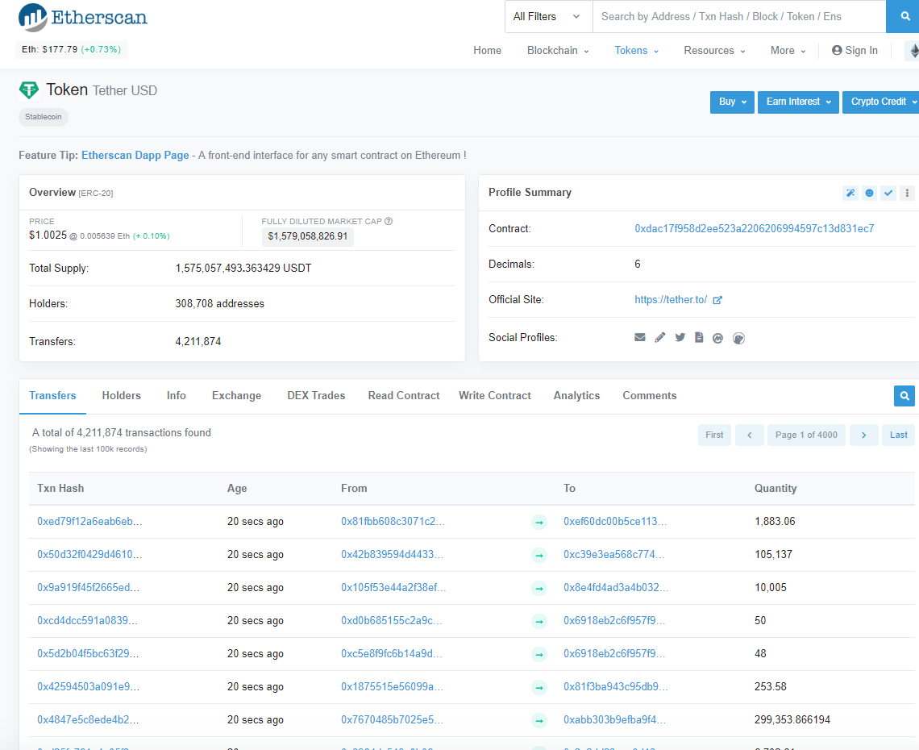
Let’s Examine Tether USD Token
Notice this contract address and decimal properties.
Notice total supply property.

Slide 7
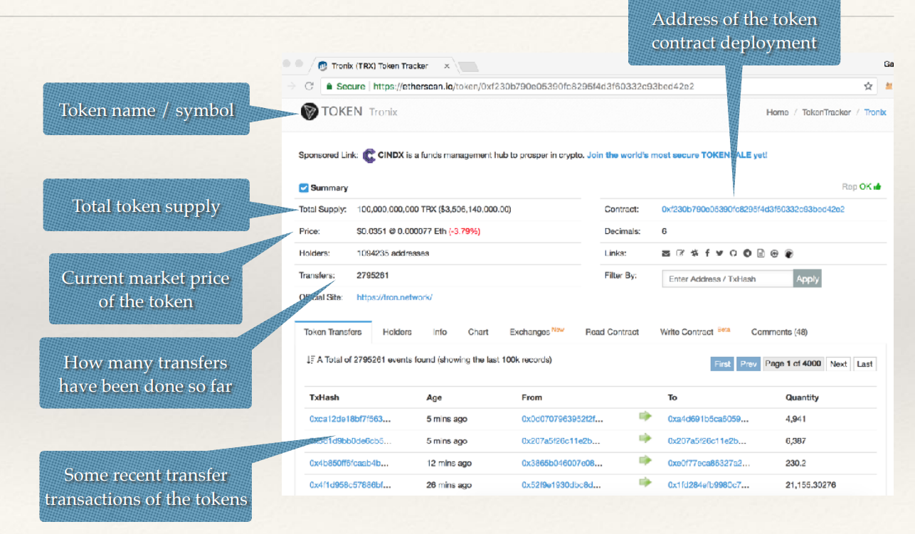
Observe a few details.

Slide 8
What are ERC20 Tokens
ERC20 is a “token standard” for creating Ethereum token contracts.
ERC stands for Ethereum Request for Comments.
Any token contract that adheres to the specification follows ERC20.
Can use with any wallets that understand ERC20.
Most ICOs (Initial Coin Offerings) have adhered to ERC20

Slide 9

Let’s create our own Token and offer it.

Slide 10
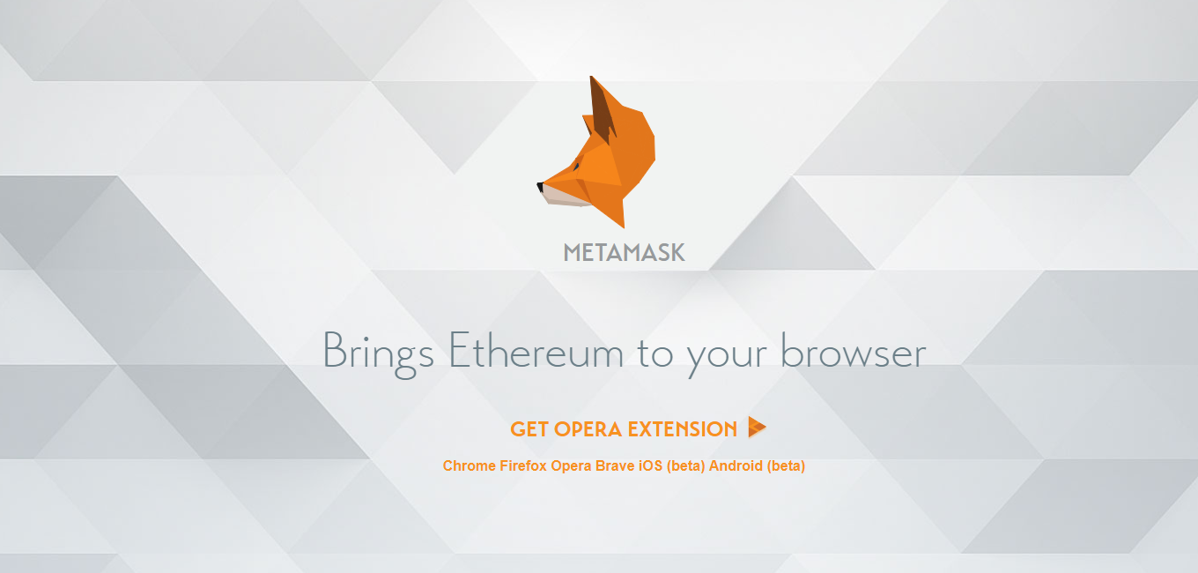
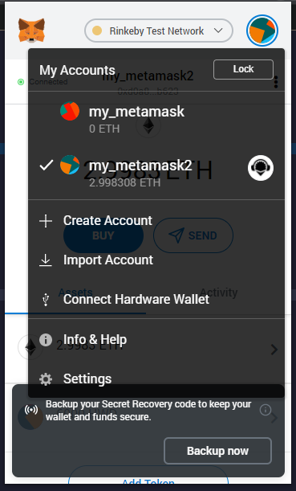
Go to: https://metamask.io
Download and install the chrome extension in your browser.
After installing the extension, it will prompt you to create an account by creating new passwords. Follow the steps in your screen.
Create two new accounts. To create second account click on the right-side circle and click on create account.
Notes:
https://metamask.io

Slide 11
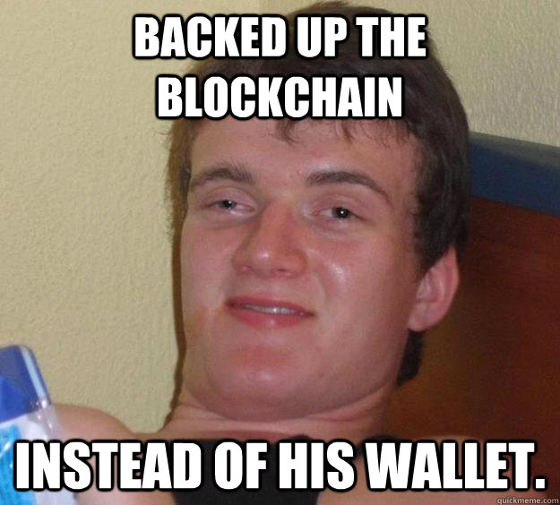

Slide 12
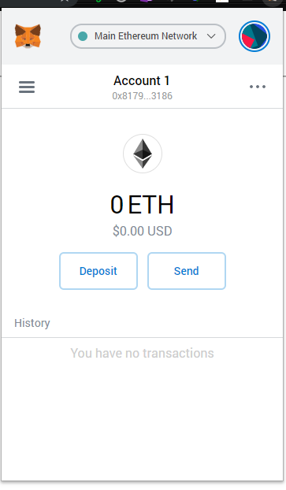
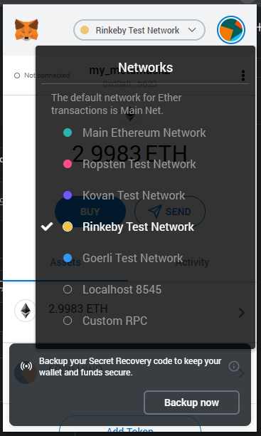
Change your network to Rinkeby Test network so that no one loses money.

Slide 13
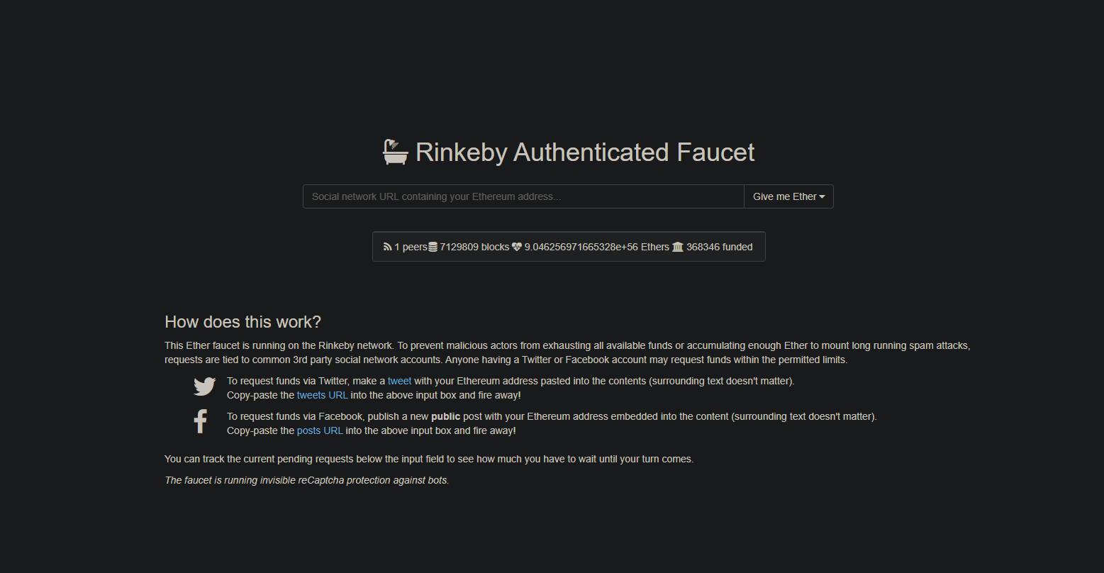
Let’s get some free Ethers to begin our own contract creation.

Slide 14
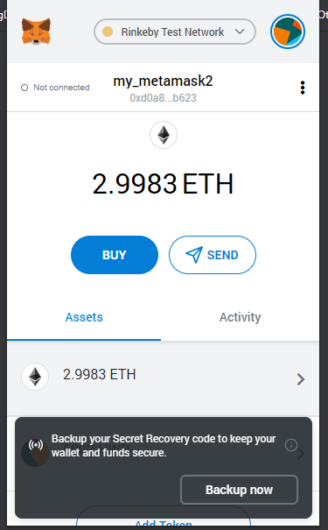
Check your Wallet. Now you will have some ethers depending on your requested amount.

Slide 15
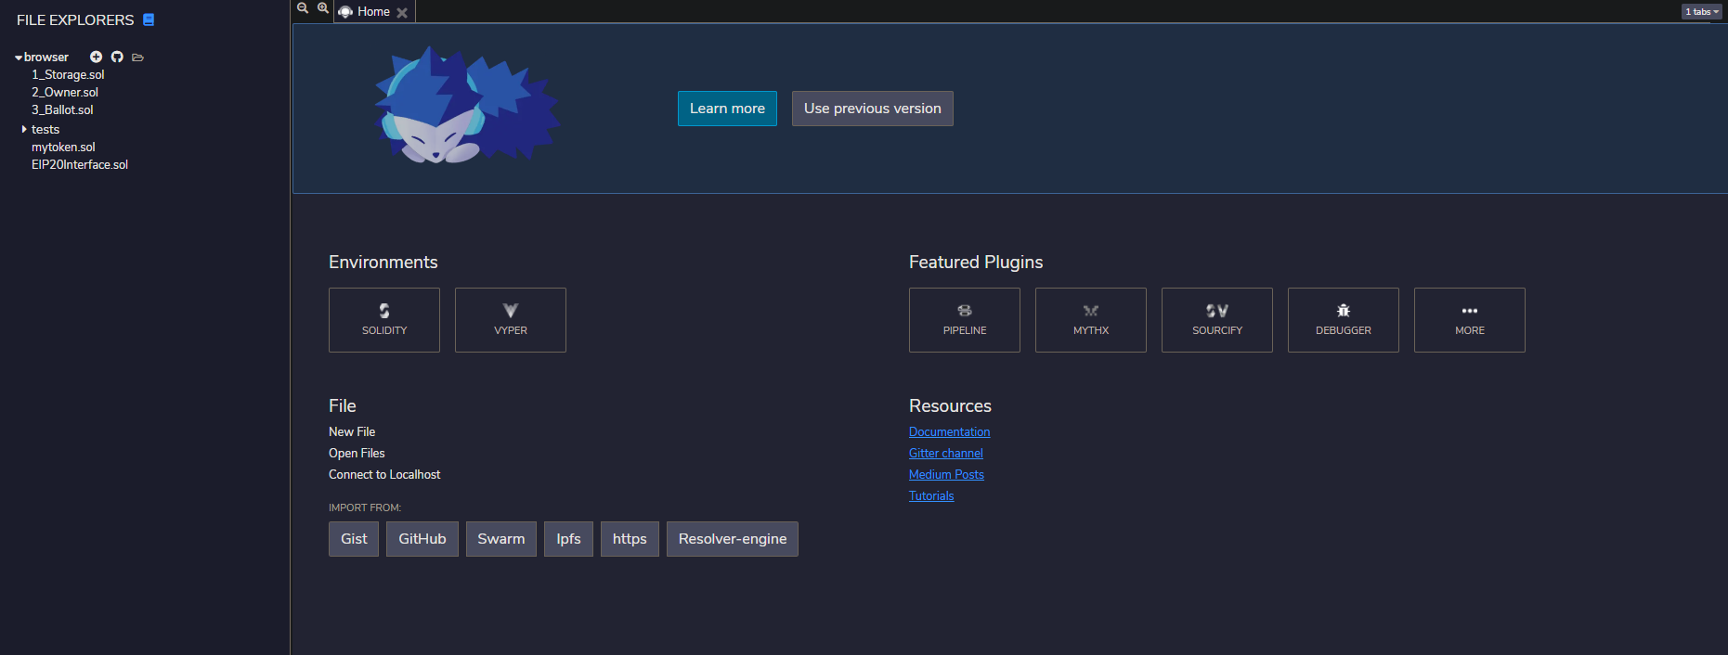
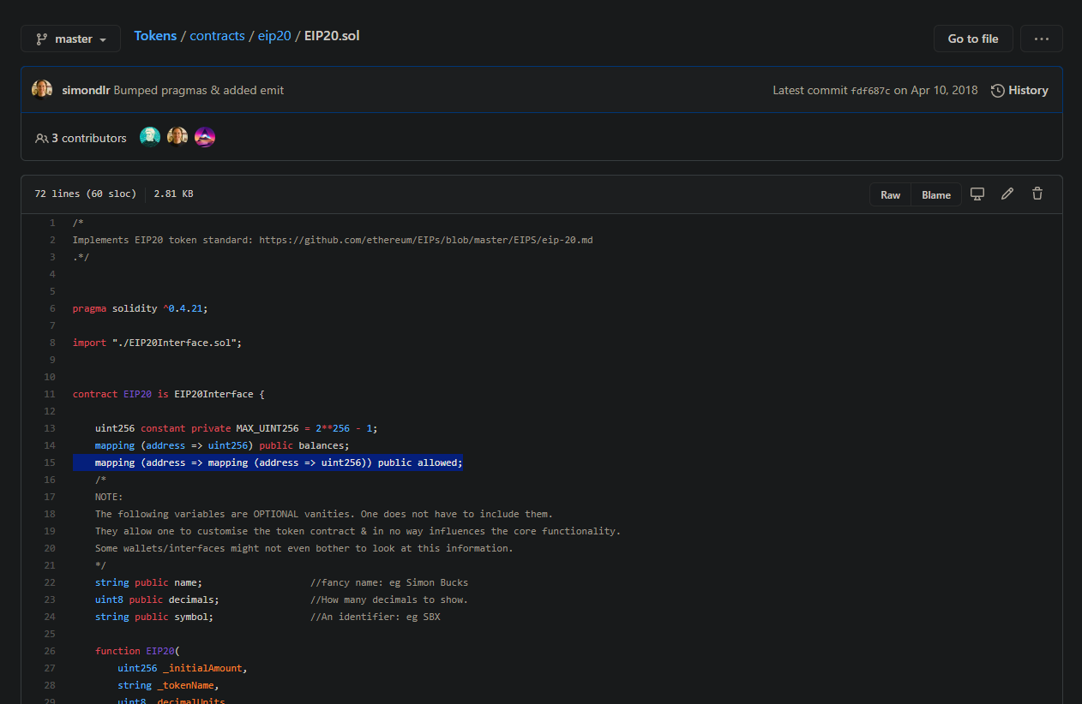
It is time to create our own Smart Contract with ERC20 interface.
Process
Open Web based IDE to compile Solidity Code
Click on New File and create two new files.
Name one file as EIP20Interface.sol and the other file anything that identifies your token.
Go to GitHub repo defining the Solidity language code for us to create smart contracts.
Copy codes from EIP20.sol file to your token file.
Notes:
https://www.myetherwallet.com

Slide 16
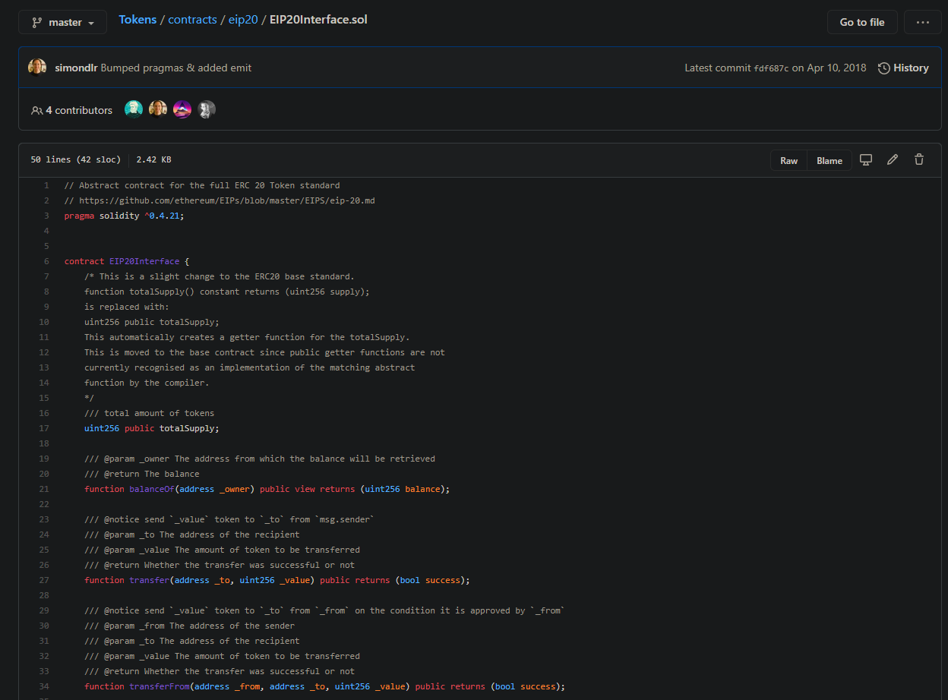
Copy the Interface Codes to EIP20Interface.sol File.

Slide 17
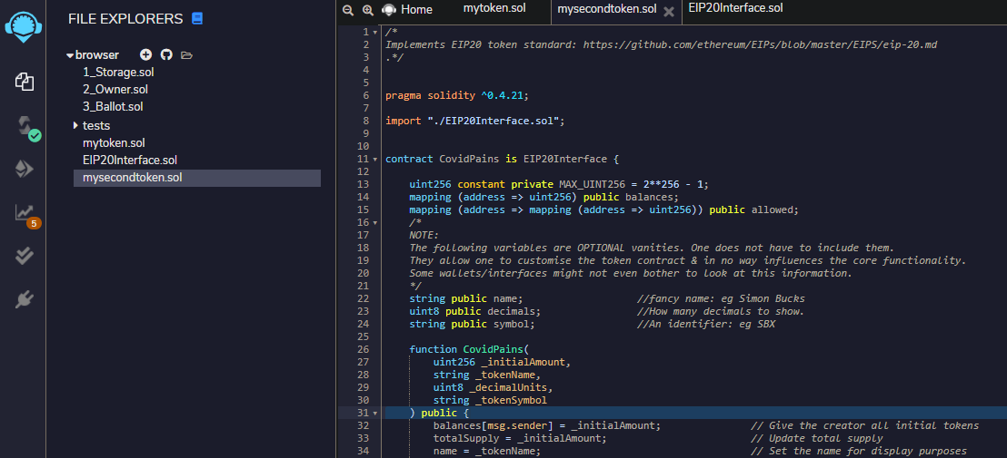
Modify Line number 7, 8, 102, 116, 117 to reflect your Token Name. In my example the token name is “CovidPains” in mysecondtoken.sol file.

Slide 18
Click on the tab to go to compiler.

Slide 19
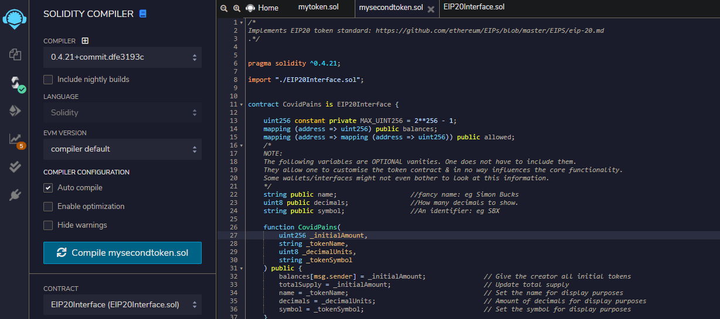
Select Compiler Version 0.4.21 and click on auto compile.

Slide 20
Click on this symbol to begin deployment procedures.

Slide 21
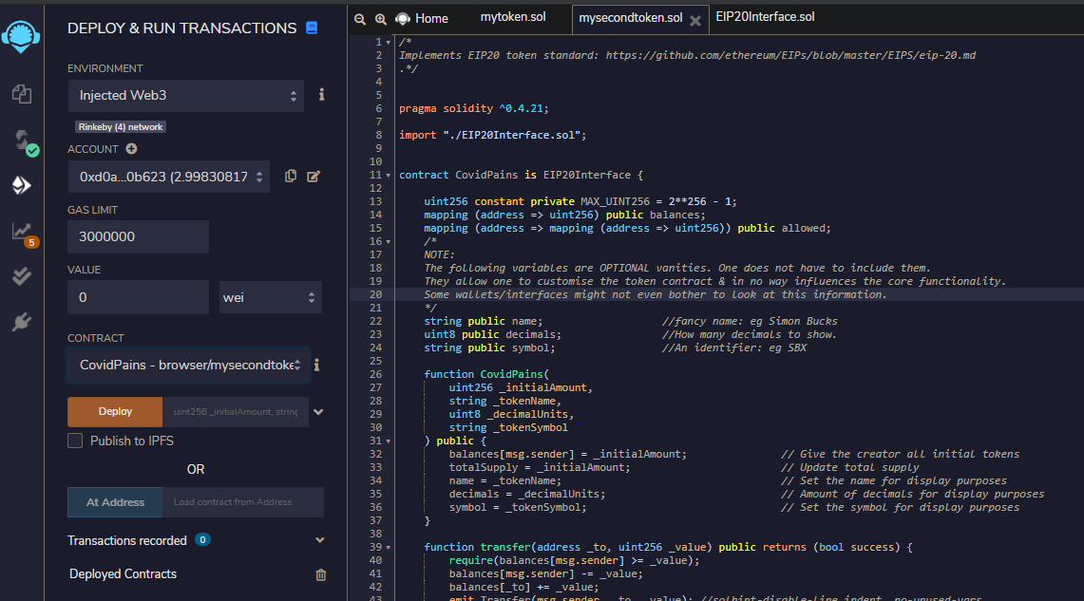
When you select Injected Web3 for first time it will ask you to link Remix to one of your Metamask accounts. Remember you need to connect with the account in which you already have some free Ethers (that you requested a minutes before). Approve connection request.
Change environment to Injected Web3
Select the correct contract file here.

Slide 22
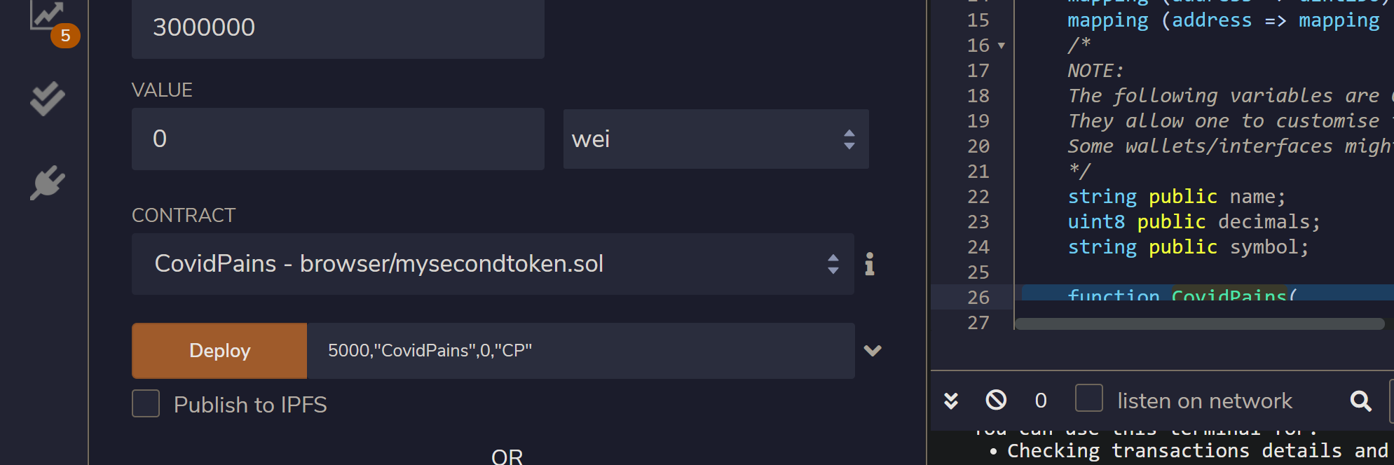
Finally we are ready to deploy but there are a few things to keep in mind:
Initial Token Amount to Issue
the division of Token to an allowed decimal point
the symbol/nickname of your token.
Insert the required fields in correct sequence. No. of token to issue in my call 5000. Name of the token in quotes. In my case “CovidPains”. Decimal points, in my case 0, and finally the code/symbol of currency in quotes. “CP”

Slide 23
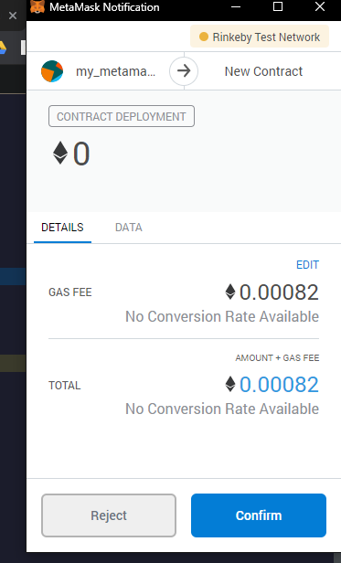
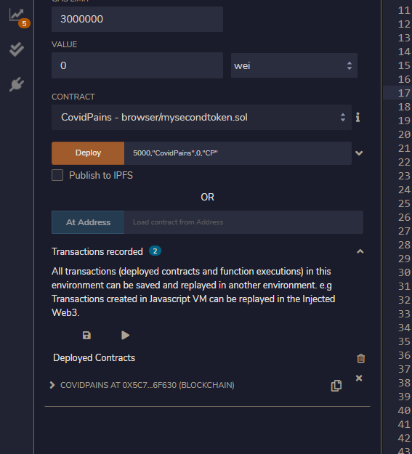
Click on Deploy.
You will receive a notification like below. Click on Approve.
This transaction will use some of your free Ethers to create the new Token.
After the transaction is completed you will see your token in the deployed contracts part. Check second image.

Slide 24
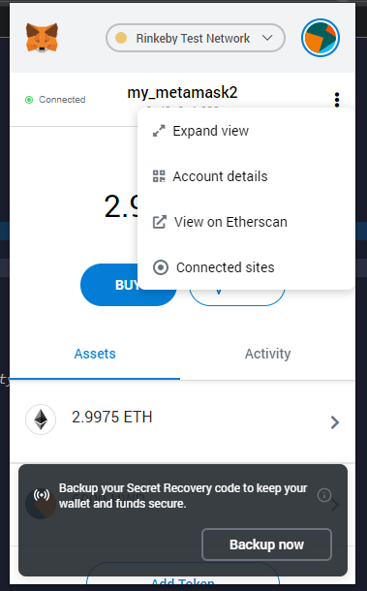
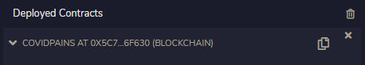
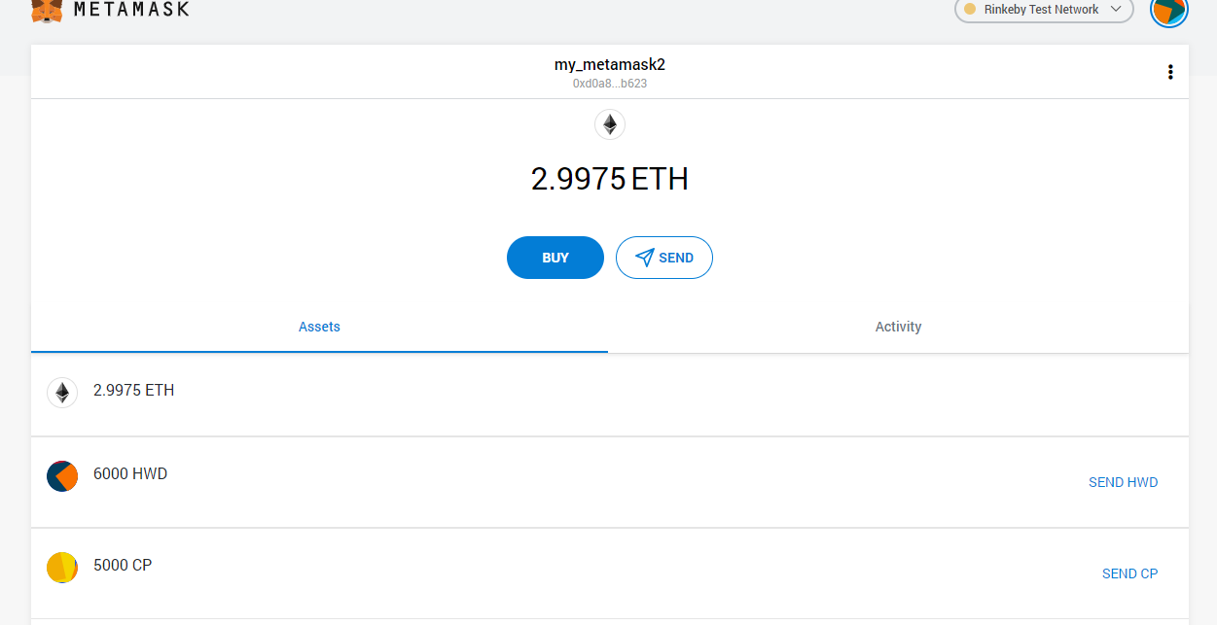
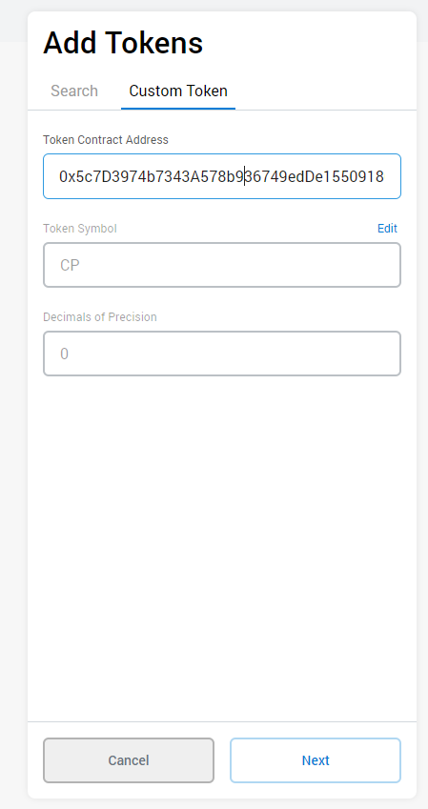
Let’s show this new token on our account. Remember it will only be visible to the account with which you created the token.
(The account that paid for the token creation). In my case it is myaccount2.
Open Metamask extension click expand view.
Click add token. Select custom token.
Copy token address from deployed contract tab.
Insert copied address, click next and click add tokens.
Now you can see your custom token in metamask.
Click here to copy token address.
Notes:
http://remix.ethereum.org/#optimize=false&evmVersion=null

Slide 25
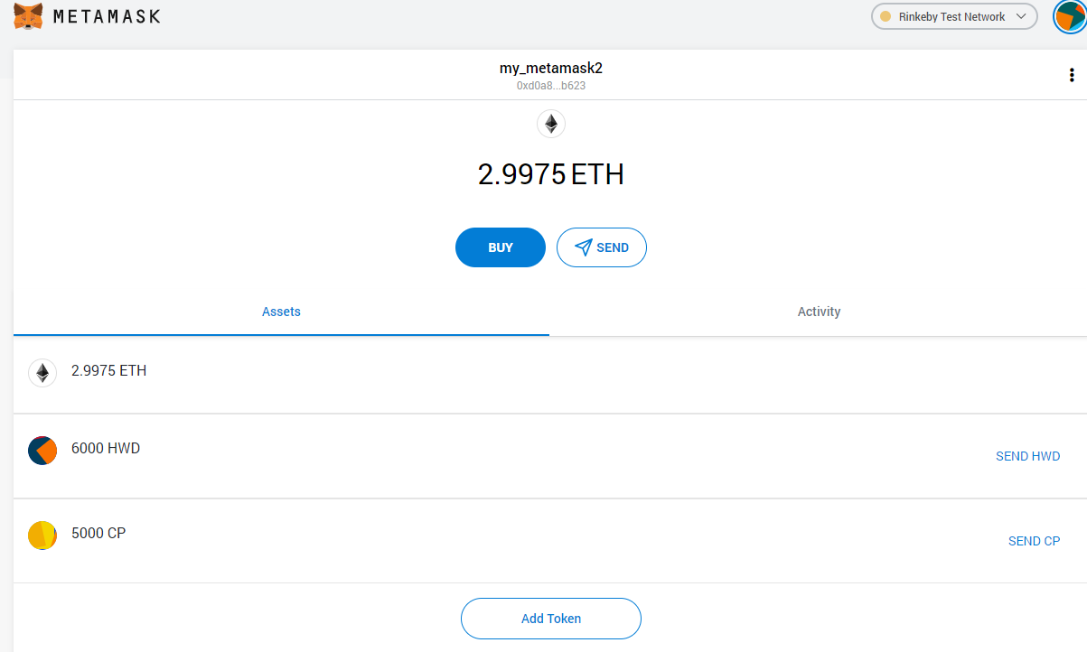
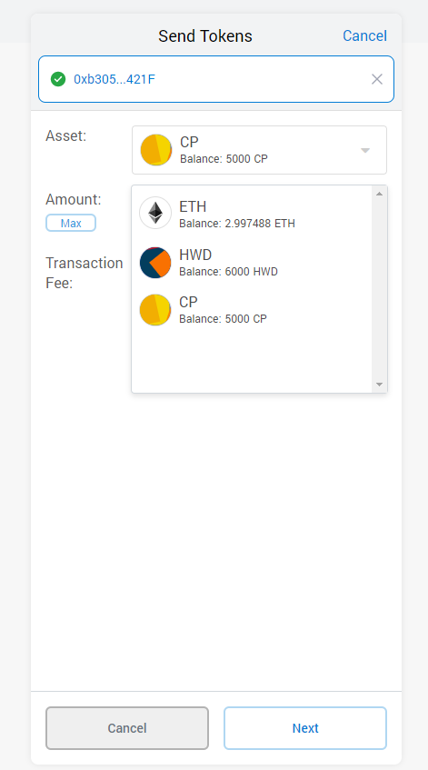
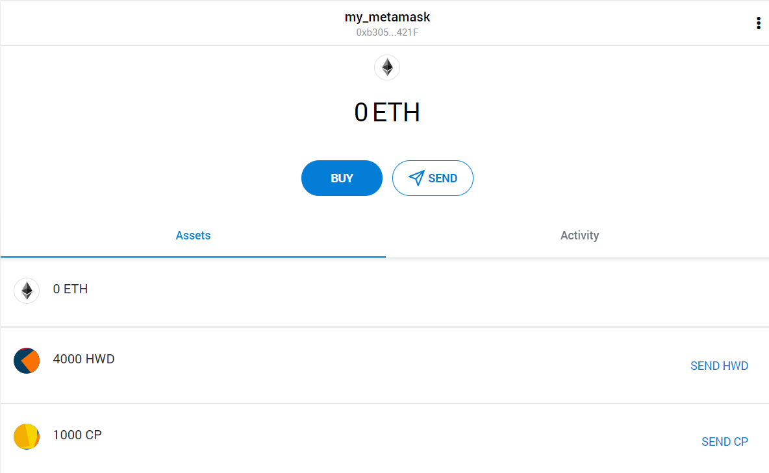
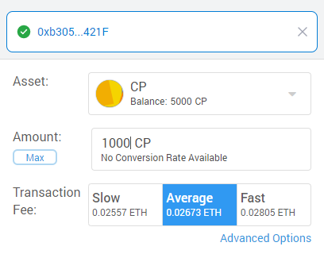
Now let’s do some transitions using custom tokens.
Click on send
Enter address of your other account or your friends' account. All account must be on rinkeby network.
Select which token to send incase you have created multiple tokens. I will select 1000 CP.
Now add custom to your other account or
Ask your friend to add the custom token to their metamask account by following the procedure in previous slide.
You will have to share your token address with your friends if you are sending to them.
After adding the custom token to your other/friends account you can see you have received 1000 CP tokens from the owner.

Slide 26
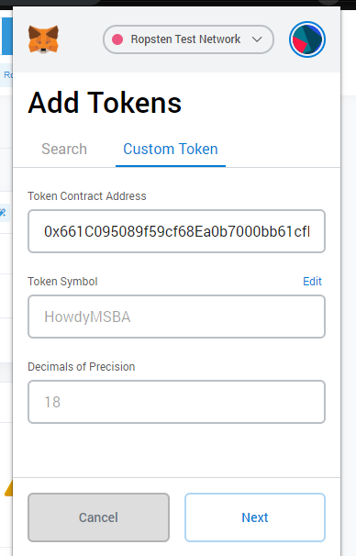
Paste the token address into the address box and all other details will appear automatically.

Slide 27


Slide 28
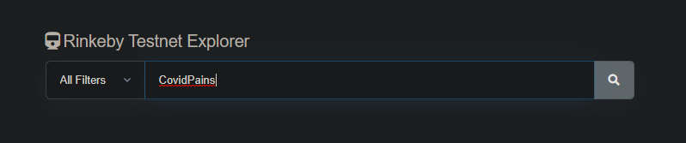
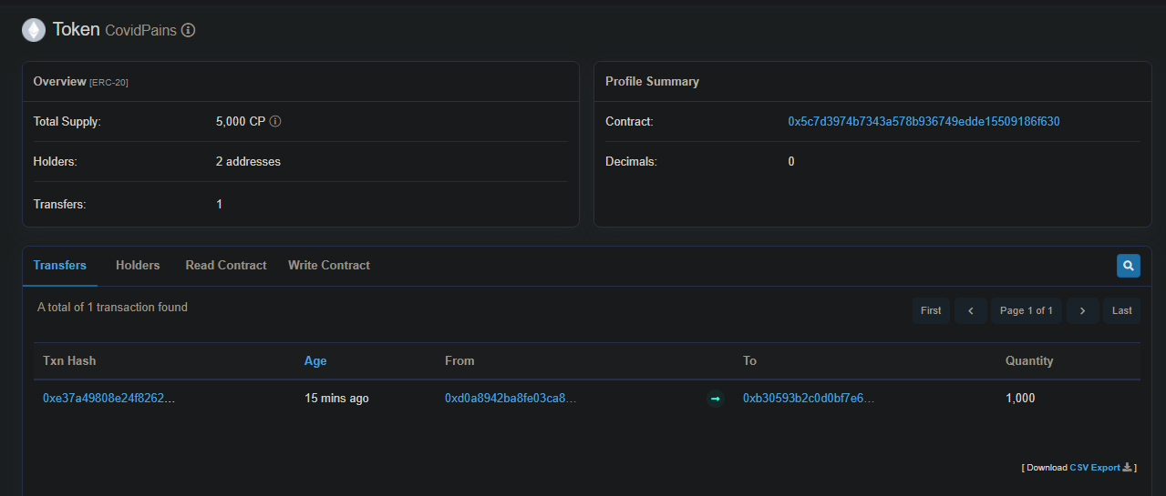
Let’s check our token details on Rinkeby Etherscan.
Go to above link and search for your token. You can find all the details of your token including the completed transactions here.

Slide 29
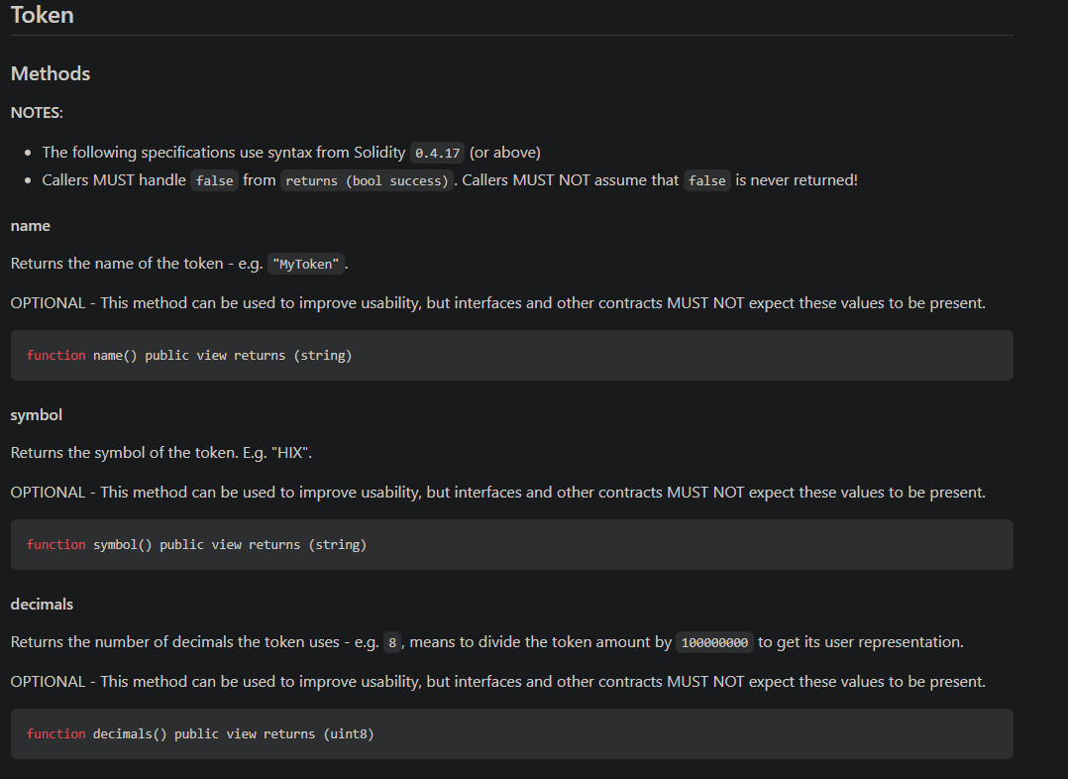
More on EIP-20: ERC-20 Token Standard and Solidity Functions

Slide 30
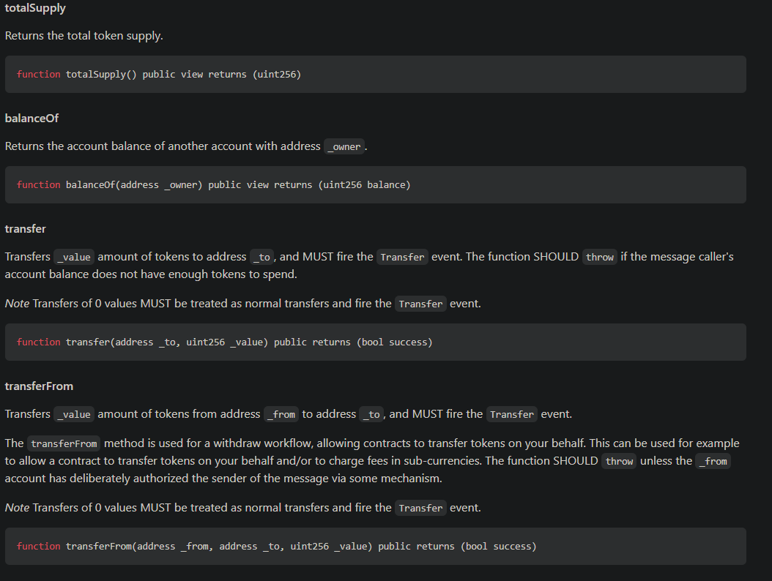

Slide 31
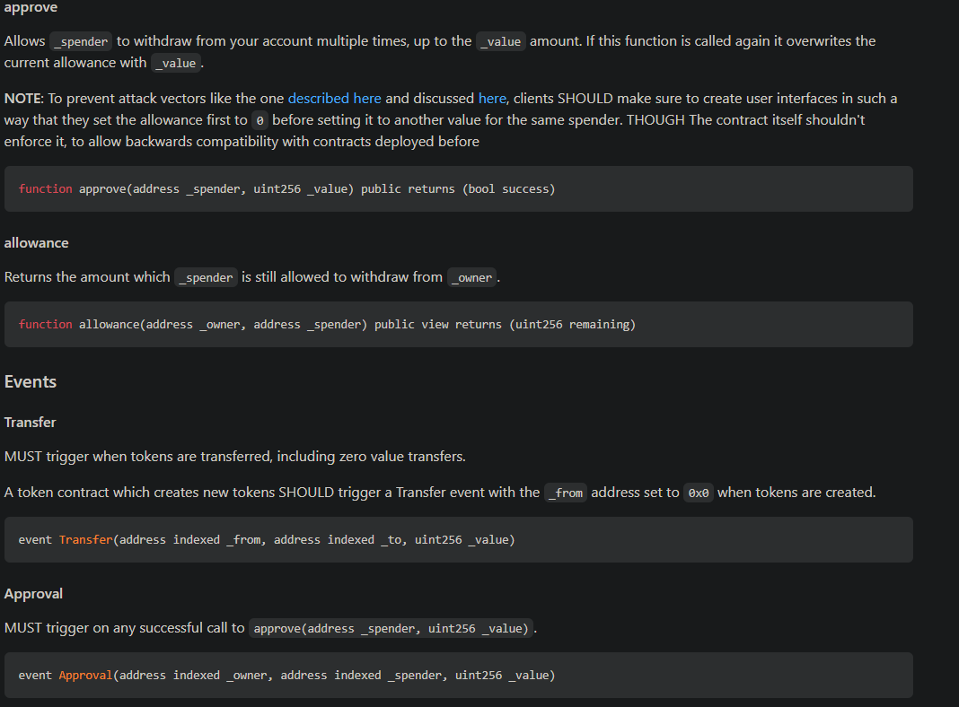

Slide 32
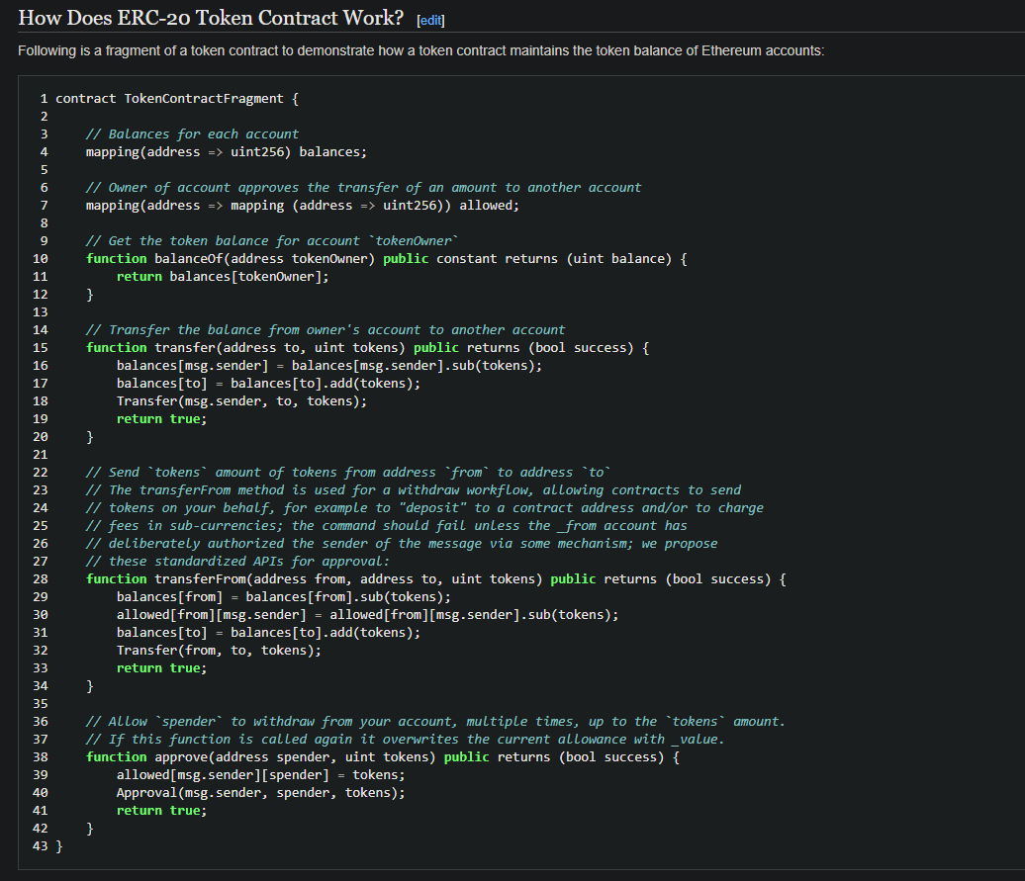

Slide 33
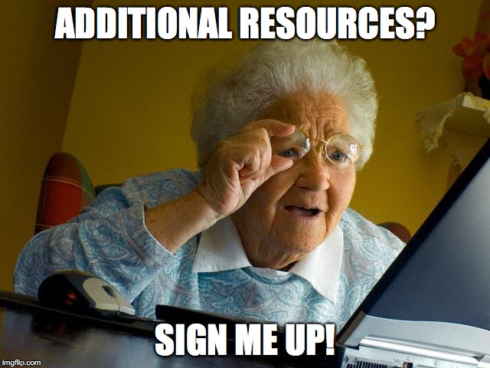
Create your own blockchain and then tokens on top of it.
Understand about smart contracts in depth.
Understand Payment infrastructure with tokens.
Inspiration for our tutorial in video format.

Slide 34
